Slide 1
Web API with ASP.NET Core and MongoDB
Rudra Chamlagain
Dot Net Developer
Braindigit IT solution

Slide 2
Prerequisites
Visual Studio 2022 install in your pc
asp.net core 6.0 SDK install in your pc
Basic programming knowledge in .NET and C# and Database
Basic Knowledge of API.

Slide 3
Agenda
Introduction to Mongo DB
Installing Mongo DB And Mongo Compass tool
Create the ASP.NET Core web API project
Installing MongoDB C# driver Package
Creating Blog Post and Category CRUD Operation.

Slide 4
Introduction MongoDB
MongoDB is a database system that allows users to store data using the document model.
It stores data in documents and collections. The data stored inside documents is typically stored in hierarchical structures like JSON, BSON (Binary JavaScript Object Notation).

Slide 5
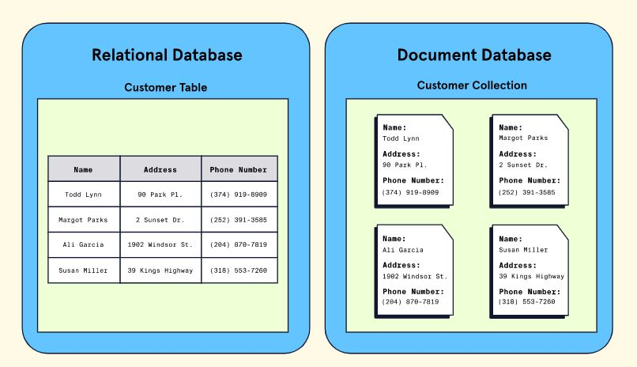
Relational DB and Document database

Slide 6
Installing MongoDB and Compass Tool.
You can download and install Mongo DB from mongodb.com site.
=> https://www.mongodb.com/try/download/community
Mongo DB Compass is the GUI tool for easily explore and manipulate your MongoDB database. You can download and install from => https://www.mongodb.com/try/download/compass

Slide 7
Create the ASP.NET Core web API project
Go to File > New > Project.
Select the ASP.NET Core Web API project type, and select Next.
Name the project MongoDBDemo, and select Next.
Select the .NET 6.0 (Long-term support) framework and select Create.

Slide 8
Installing .NET Driver for Mongo DB and Configure
In the Package Manager Console window, navigate to the project root. Run the following command to install the .NET driver for MongoDB Install-Package MongoDB.Driver
Creating MongoContext helper class for to set connection , get database and get collection. And Mongo Collection Constant.

Slide 9
Creating Models and CRUD Operation.
Insert Data.
Update Data
Get Data with pagination
Get Data with aggregation and filter.

Slide 10
Thank you

